Slide 1
UC Berkeley’s CS61A – Lecture 13 – Trees
Fib fun on Piano: https://youtu.be/IGJeGOw8TzQ
Your Smart Light Can Tell Amazon and Google When You Go to Bed
www.bloombergquint.com/pursuits/your-smart-light-can-tell-amazon-and-google-when-you-go-to-bed
“Amazon and Google want smart home device manufacturers to have smart appliances transmit a continuous stream of customer information to data hubs by modifying their code. The companies said they collect the data to make it easier for consumers to manage home electronics, although some device makers say such data collection doesn’t give users enough control over what data they share, or how it can be used. Park Associates' Brad Russell said, "You can learn the behaviors of a household based on their patterns." One smart device maker, Logitech, is trying to partly fulfill this mandate: instead of telling smart speakers what each device connected to Logitech's Harmony remote controls are doing, the company reports back with broad descriptions, specifying that a user is watching TV, rather than passing on information about their choice of channel, for example.”

Slide 2
Announcements
Optional Hog strategy contest ends TODAY Friday 2/22.
Hog Composition Scores have been released
You can find your score and any comments on your Hog submission on Ok
Submit revisions (via python3 ok --revise) by Tuesday, February 26th to recover any lost points!
Maps (SOLO – no partners) Project released and due Thursday 2/28 (8 days!)
Submit a day early (Wednesday 2/27) to receive 1 extra credit point

Slide 3
Limitations on Dictionaries (from last time)
Dictionaries are unordered collections of key-value pairs
Dictionary keys do have two restrictions:
A key of a dictionary cannot be a list or a dictionary (or any mutable type)
Two keys cannot be equal; There can be at most one value for a given key
This first restriction is tied to Python's underlying implementation of dictionaries
The second restriction is part of the dictionary abstraction
If you want to associate multiple values with a key, store them all in a sequence value

Slide 4
Box-and-Pointer Notation

Slide 5
The Closure Property of Data Types
A method for combining data values satisfies the closure property if: The result of combination can itself be combined using the same method
Closure is powerful because it permits us to create hierarchical structures
Hierarchical structures are made up of parts, which themselves are made up of parts, and so on
Lists can contain lists as elements (in addition to anything else)

Slide 6
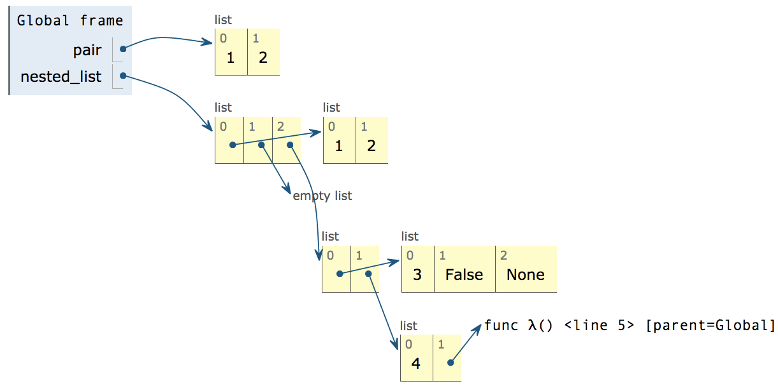
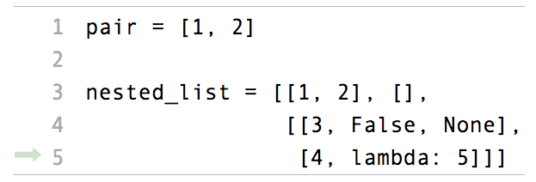
Box-and-Pointer Notation in Environment Diagrams
Lists are represented as a row of index-labeled adjacent boxes, one per element
Each box either contains a primitive value or points to a compound value

Slide 7
Box-and-Pointer Notation in Environment Diagrams
Lists are represented as a row of index-labeled adjacent boxes, one per element
Each box either contains a primitive value or points to a compound value
pythontutor.com/composingprograms.html#code=pair%20%3D%20[1,%202]%0A%0Anested_list%20%3D%20[[1,%202],%20[],%0A%20%20%20%20%20%20%20%20%20%20%20%20%20%20%20[[3,%20False,%20None],%0A%20%20%20%20%20%20%20%20%20%20%20%20%20%20%20%20[4,%20lambda%3A%205]]]&mode=display&origin=composingprograms.js&cumulative=true&py=3&rawInputLstJSON=[]&curInstr=4

Slide 8
Slicing
(Demo1)

Slide 9
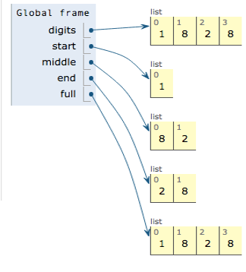
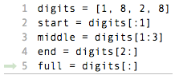
Slicing Creates New Values
pythontutor.com/composingprograms.html#code=digits%20%3D%20[1,%208,%202,%208]%0Astart%20%3D%20digits[%3A1]%0Amiddle%20%3D%20digits[1%3A3]%0Aend%20%3D%20digits[2%3A]%0Afull%20%3D%20digits[%3A]&cumulative%3Dtrue&curInstr%3D5&mode=display&origin=composingprograms.js&py=3&rawInputLstJSON=[]

Slide 10
Processing Container Values

Slide 11
Sequence Aggregation (Demo2 after each one)
Several built-in functions take iterable arguments and aggregate them into a value
sum(iterable[, start]) -> value Return the sum of an iterable (not of strings) plus the value of parameter 'start' (which defaults to 0). When the iterable is empty, return start.
max(iterable[, key=func]) -> value max(a, b, c, ...[, key=func]) -> value With a single iterable argument, return its largest item. With two or more arguments, return the largest argument.
all(iterable) -> bool Return True if bool(x) is True for all values x in the iterable. If the iterable is empty, return True.

Slide 12
Trees

Slide 13
Tree Abstraction
or Root Node
Root of the whole tree
Nodes
Root label
3
Labels
Root of a branch
Branch
1
2
(also a tree)
0
1
1
1
Leaf
0
1
(also a tree)
Path
Recursive description (wooden trees):
A tree has a root label and a list of branches
Each branch is a tree
A tree with zero branches is called a leaf
A tree starts at the root
Relative description (family trees):
Each location in a tree is called a node
Each node has a label that can be any value
One node can be the parent/child of another
The top node is the root node
People often refer to labels by their locations: "each parent is the sum of its children"

Slide 14
Implementing the Tree Abstraction
def tree(label, branches=[]):
A tree has a root label and a list of branches
Each branch is a tree
return [label] + branches
def label(tree):
return tree[0]
def branches(tree):
return tree[1:]
3
1
2
1
1
>>> tree(3, [tree(1),
... tree(2, [tree(1),
... tree(1)])])
[3, [1], [2, [1], [1]]]

Slide 15
Implementing the Tree Abstraction
def tree(label, branches=[]):
A tree has a root label and a list of branches
Each branch is a tree
for branch in branches:
assert is_tree(branch)
return [label] + list(branches)
Verifies the tree definition
Creates a list from a sequence of branches
3
def label(tree):
return tree[0]
def branches(tree):
return tree[1:]
1
2
Verifies that tree is bound to a list
1
1
def is_tree(tree):
if type(tree) != list or len(tree) < 1:
return False
for branch in branches(tree):
if not is_tree(branch):
return False
return True
>>> tree(3, [tree(1),
... tree(2, [tree(1),
... tree(1)])])
[3, [1], [2, [1], [1]]]
def is_leaf(tree):
return not branches(tree)
(Demo3)

Slide 16
Example: Printing Trees
(Demo4a)

Slide 17
Tree Processing
(Demo4)

Slide 18
Tree Processing Uses Recursion
Processing a leaf is often the base case of a tree processing function
The recursive case typically makes a recursive call on each branch, then aggregates
def count_leaves(t):
"""Count the leaves of a tree."""
if is_leaf(t):
return 1
else:
branch_counts = [count_leaves(b) for b in branches(t)]
return sum(branch_counts)
(Demo5)

Slide 19
Discussion Question
Implement leaves, which returns a list of the leaf labels of a tree
Hint: If you sum a list of lists, you get a list containing the elements of those lists
>>> sum([ [1], [2, 3], [4] ], [])
[1, 2, 3, 4]
>>> sum([ [1] ], [])
[1]
>>> sum([ [[1]], [2] ], [])
[[1], 2]
def leaves(tree):
"""Return a list containing the leaf labels of tree.
>>> leaves(fib_tree(5))
[1, 0, 1, 0, 1, 1, 0, 1]
"""
if is_leaf(tree):
return [label(tree)]
else:
return sum(______________________________, [])
List of leaf labels for each branch
branches(tree)
[b for b in branches(tree)]
leaves(tree)
[s for s in leaves(tree)]
[branches(b) for b in branches(tree)]
[branches(s) for s in leaves(tree)]
[leaves(b) for b in branches(tree)]
[leaves(s) for s in leaves(tree)]

Slide 20
Creating Trees
A function that creates a tree from another tree is typically also recursive
def increment_leaves(t):
"""Return a tree like t but with leaf labels incremented."""
if is_leaf(t):
return tree(label(t) + 1)
else:
bs = [increment_leaves(b) for b in branches(t)]
return tree(label(t), bs)
def increment(t):
"""Return a tree like t but with all labels incremented."""
return tree(label(t) + 1, [increment(b) for b in branches(t)])
def tree_map(t,f):
"""Return a tree like t but with all labels having f applied to them."""
return tree(f(label(t)), [tree_map(b,f) for b in branches(t)])

